Slide 1


Network protocols & security
24EC2210
Topic:
Congestion Control
Session - 28

Slide 2
Congestion Control
Data Traffic
The main focus of congestion control and quality of service is data traffic.
In congestion control we try to avoid traffic congestion.
In quality of service, we try to create an appropriate environment for the traffic.

Slide 3
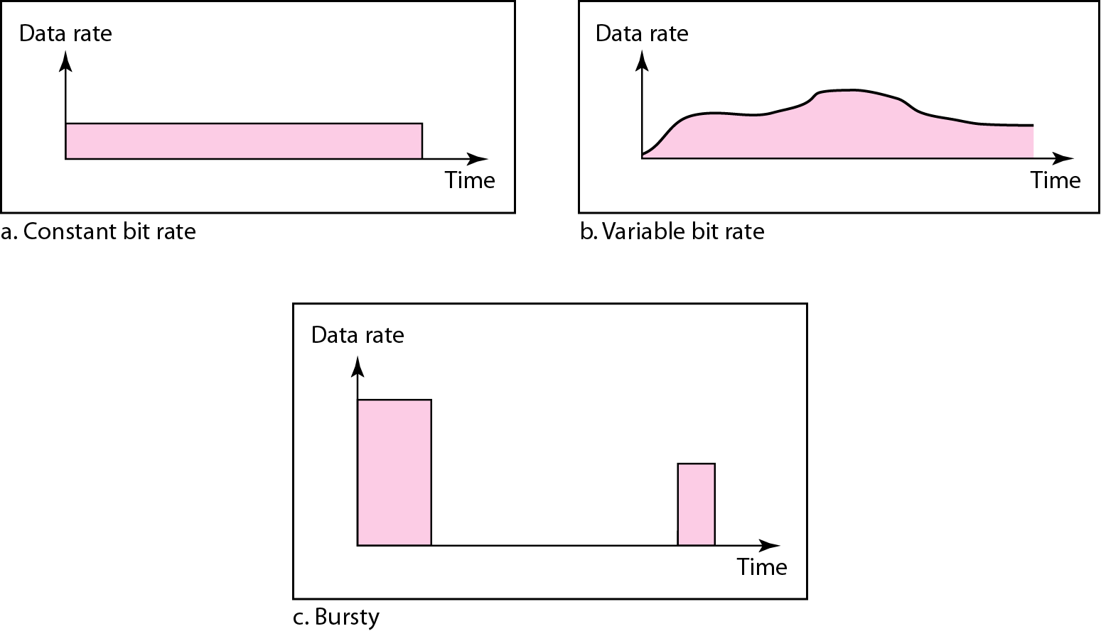
Three traffic profiles
Constant Bit Rate
A constant-bit-rate (CBR), or a fixed-rate, traffic model has a data rate that does not change. In this type of flow, the average data rate and the peak data rate are the same.
The network knows in advance how much bandwidth to allocate for this type of flow.
Variable Bit Rate
In the variable-bit-rate (VBR) category, the rate of the data flow changes in time. In this type of flow, the average data rate and the peak data rate are different.
Bursty
In the bursty data category, the data rate changes suddenly in a very short time. It may jump from zero, for example, to 1 Mbps in a few microseconds and vice versa. Bursty traffic is one of the main causes of congestion in a network.

Slide 4
Congestion
An important issue in a packet-switched network is congestion.
Congestion in a network may occur if the load on the network (the number of packets sent to the network) is greater than the capacity of the network (the number of packets a network can handle).
Congestion control refers to the mechanisms and techniques to control the congestion and keep the load below the capacity.
Congestion happens in any system that involves waiting.
Congestion cannot be completely avoided.

Slide 5
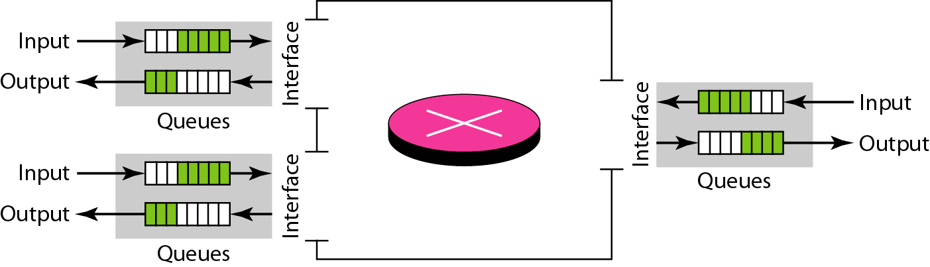
Congestion in a network or internetwork occurs because routers and switches have queues-buffers that hold the packets before and after processing.
A router, for example, has an input queue and an output queue for each interface. When a packet arrives at the incoming interface, it undergoes three steps before departing, as shown in Figure
Queues in a router
Continue.,.

Slide 6
Queues policy
The packet is put at the end of the input queue while waiting to be checked.
The processing module of the router removes the packet from the input queue once it reaches the front of the queue and uses its routing table and the destination address to find the route.
The packet is put in the appropriate output queue and waits its turn to be sent.
We need to be aware of two issues.
First, if the rate of packet arrival is higher than the packet processing rate, the input queues become longer and longer.
Second, if the packet departure rate is less than the packet processing rate, the output queues become longer and longer.

Slide 7
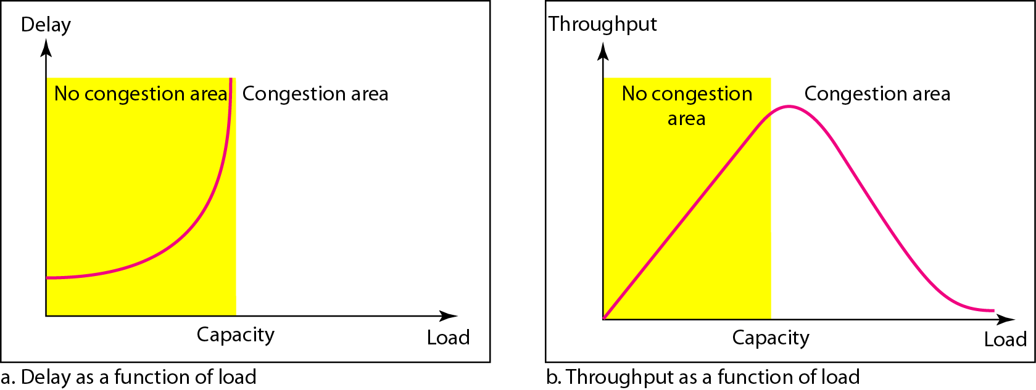
Network Performance
Congestion control involves two factors that measure the performance of a network: delay and throughput. Figure shows these two performance measures as function of load.

Slide 8
Congestion Control mechanisms
Congestion control refers to techniques and mechanisms that can either prevent congestion, before it happens, or remove congestion, after it has happened.
In general, we can divide congestion control mechanisms into two broad categories:
Open-loop congestion control
Closed-loop congestion control.

Slide 9
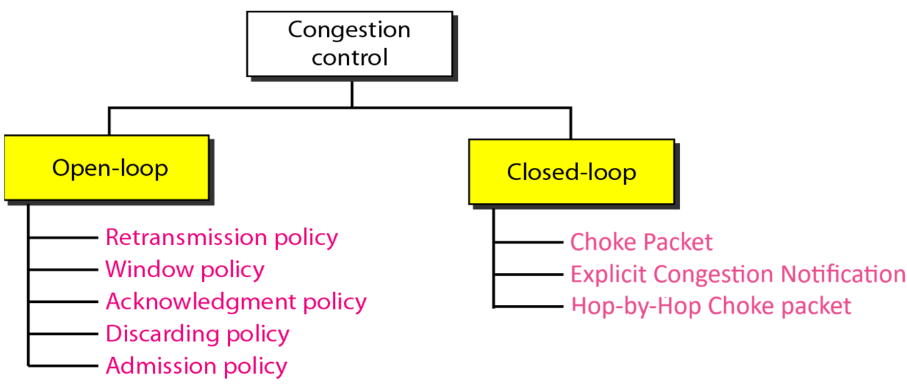
Congestion control categories
Policies adopted by open & closed loop congestion control

Slide 10
Open Loop Congestion Control

Slide 11
Open Loop Congestion Control
Open loop congestion control policies are applied to prevent congestion before it happens.
The congestion control is handled either by the source or the destination.
Retransmission Policy
If the sender feels that a sent packet is lost or corrupted, the packet needs to be retransmitted. This transmission may increase the congestion in the network.
To prevent congestion, retransmission timers must be designed to prevent congestion and also able to optimize efficiency.
Window Policy
The type of window at the sender’s side may also affect the congestion. Several packets in the Go-back-n window are re-sent, although some packets may be received successfully at the receiver side. This duplication may increase the congestion in the network and make it worse.
Therefore, Selective repeat window should be adopted as it sends the specific packet that may have been lost.

Slide 12
Discarding Policy
A good discarding policy adopted by the routers is that the routers may prevent congestion and at the same time partially discard the corrupted or less sensitive packets and also be able to maintain the quality of a message.
In case of audio file transmission, routers can discard less sensitive packets to prevent congestion and also maintain the quality of the audio file.
Acknowledgment Policy
Since acknowledgements are also the part of the load in the network, the acknowledgment policy imposed by the receiver may also affect congestion. Several approaches can be used to prevent congestion related to acknowledgment.
The receiver should send acknowledgement for N packets rather than sending acknowledgement for a single packet. The receiver should send an acknowledgment only if it has to send a packet(Piggybacking) or a timer expires.

Slide 13
Admission Policy
In admission policy a mechanism should be used to prevent congestion. Switches in a flow should first check the resource requirement of a network flow before transmitting it further. If there is a chance of a congestion or there is a congestion in the network, router should deny establishing a virtual network connection to prevent further congestion
All the above policies are adopted to prevent congestion before it happens in the network

Slide 14
Closed Loop Congestion Control

Slide 15
Congestion control categories
Closed loop congestion control techniques are used to treat or alleviate congestion after it happens.
Several techniques are used by different protocols; some of them are listed here.

Slide 16
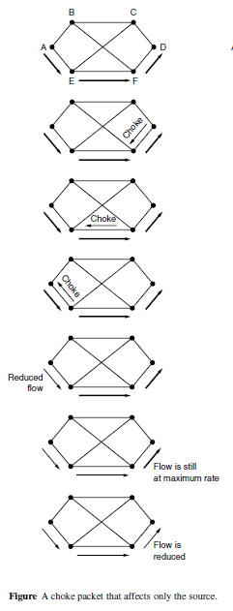
1. Choke Packets
The most direct way to notify a sender of congestion is to tell it directly.
In this approach, the router selects a congested packet and sends a choke packet back to the source host, giving it the destination found in the packet.
When the source host gets the choke packet, it is required to reduce the traffic sent to the specified destination, for example, by 50%.

Slide 17
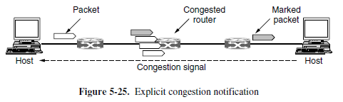
2.ECN (Explicit Congestion Notification)
Used in internet.
Instead of generating additional packets to warn of congestion, a router can tag any packet it forwards (by setting a bit in the packet’s header) to signal that it is experiencing congestion.
When the network delivers the packet, the destination can note that there is congestion and inform the sender when it sends a reply packet.
The sender can then throttle its transmissions.

Slide 18
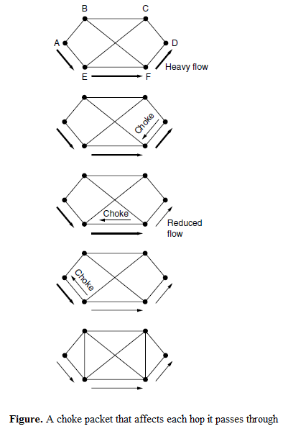
3.Hop-by-Hop Backpressure
At high speeds or over long distances, many new packets may be transmitted after congestion has been signaled because of the delay before the signal takes effect.
An ECN indication will take even longer because it is delivered via the destination.
An alternative approach(Hop-by-Hop) is to have the choke packet take effect at every hop it passes through

Slide 19
THANK YOU
Team –Network Protocols and Security

